Slide 1
Multi-Objective Reinforcement Learning
Analysing Human Preference Application
Max Cunningham
Date 21/03/25

Slide 2
Overview
Motivation & Objective
Background & Related Work
Design
Implementation
Evaluation
Conclusions

Slide 3





Motivation & Objective
Motivation
Complex Environments
with Multiple Objectives
Groups of Humans with Different, Complex, Dynamic Preferences

Slide 4
Motivation & Objective
Objective
Review:
The current state-of-the-art MORL Models
Methods of Human Preference Integration
Design a Collaborative ML Architecture with Post-Hoc Preference integration.
Test and Evaluate the Novel Architecture against DWN.
Analyse the the Impact of Human Preference integration.

Slide 5
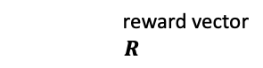
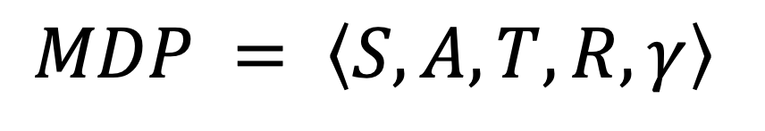
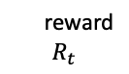
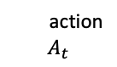
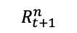
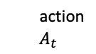
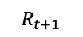
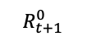
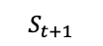
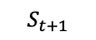
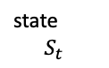
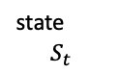
Background & Related Work
RL vs MORL
Reinforcement Learning (RL)
Multi-Objective RL (MORL)
Agent
Agent
Goal = Maximize Reward
state
$$S_{t}$$
reward vector
$$R$$
state
$$S_{t}$$
reward
$$R_{t}$$
action
$$A_{t}$$
action
$$A_{t}$$
$$R_{t+1}^{n}$$
Environment
$$R_{t+1}$$
Environment
$$R_{t+1}^{0}$$
$$S_{t+1}$$
$$S_{t+1}$$
$$MDP = \left\langle S, A, T, R, γ\right\rangle$$
[1,5,7]

Slide 6
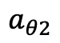
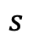
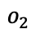
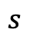
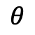
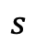
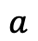
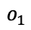
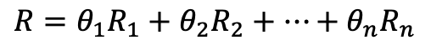
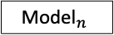
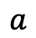
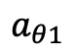
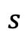
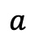
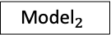
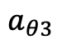
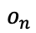
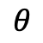
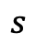
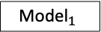
Background & Related Work
MORL Approaches
Scalarization
Multi-Solution
$$R={θ_{1}R}_{1}+θ_{2}R_{2}+…+θ_{n}R_{n}$$
$$s$$
Model
$$a_{θ1}$$
Model
Model
$$s$$
$$a$$
$$s$$
$$a_{θ2}$$
$$s$$
Model
$$a_{θ3}$$
[2,5,9]
[6,8,11]
Preference Learning
Multi-Policy
$$θ$$
Model
$$s$$
Model
$${\text{Model}}_{1}$$
$$o_{1}$$
Selector
$$θ$$
$$a$$
$$s$$
$${\text{Model}}_{2}$$
$$o_{2}$$
$$a$$
$${\text{Model}}_{n}$$
$$o_{n}$$
[10,13]
[4,12,14]

Slide 7


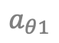

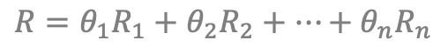

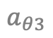



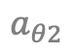
Background & Related Work
MORL Approaches
Scalarization
Multi-Solution
$$R={θ_{1}R}_{1}+θ_{2}R_{2}+…+θ_{n}R_{n}$$
$$s$$
Model
$$a_{θ1}$$
Model
Model
$$s$$
$$a$$
$$s$$
$$a_{θ2}$$
$$s$$
Model
$$a_{θ3}$$
[2,5,9]
[6,8,11]
Preference Learning
Multi-Policy
$$θ$$
Model
$$s$$
Model
$${\text{Model}}_{1}$$
$$o_{1}$$
Selector
$$θ$$
$$a$$
$$s$$
$${\text{Model}}_{2}$$
$$o_{2}$$
$$a$$
$${\text{Model}}_{n}$$
$$o_{n}$$
[10,13]
[4,12,14]

Slide 8
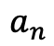
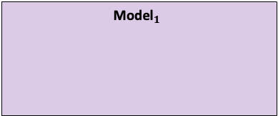
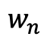
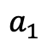
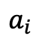
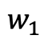
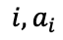
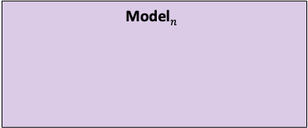
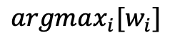
Background & Related Work
Deep W-Learning / W-Networks
DWN
$${\text{Model}}_{1}$$
$$a_{1}$$
Selector
DQN
W-network
$$w_{1}$$
$$argmax_{i}[w_{i}]$$
Select the action with the highest associated W-Value
$${\text{Model}}_{n}$$
$$a_{n}$$
DQN
W-network
$$w_{n}$$
$$i,a_{i}$$
State
Environment
$$a_{i}$$
Reward N
Reward 1
$$Q_{j}\left(s_{t},a_{t,i}\right)←Q\left(s_{t},a_{t,i}\right)+α_{q}\left[r_{t,j}+γ{\max_{ }}_{a_{t+1}}{Q\left(s_{t+1},a_{t+1}\right)}−Q\left(s_{t}, a_{t,i}\right)\right]$$
[1]
$$W_{j}\left(s_{t}\right)←\left(1−α_{w}\right)W_{j}\left(s_{t}\right)+α_{w}\left[Q_{j}\left(s_{t},a_{i}\right)−\left(r_{t,j}+γ\max_{a^{′}}{Q_{j}\left(s_{t+1},a^{′}\right)} \right)\right]$$
[3, 4]

Slide 9
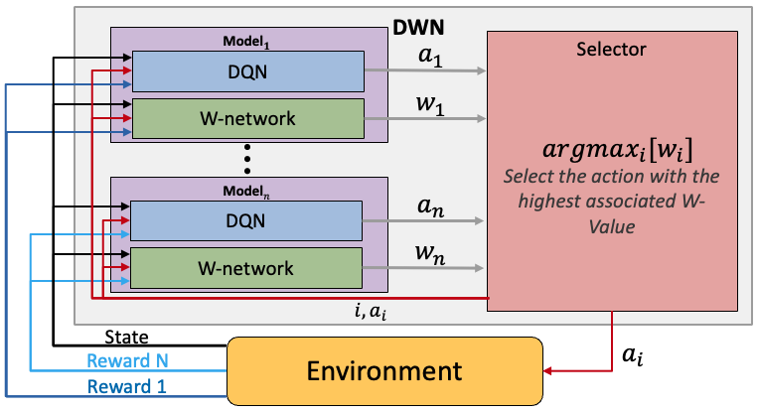
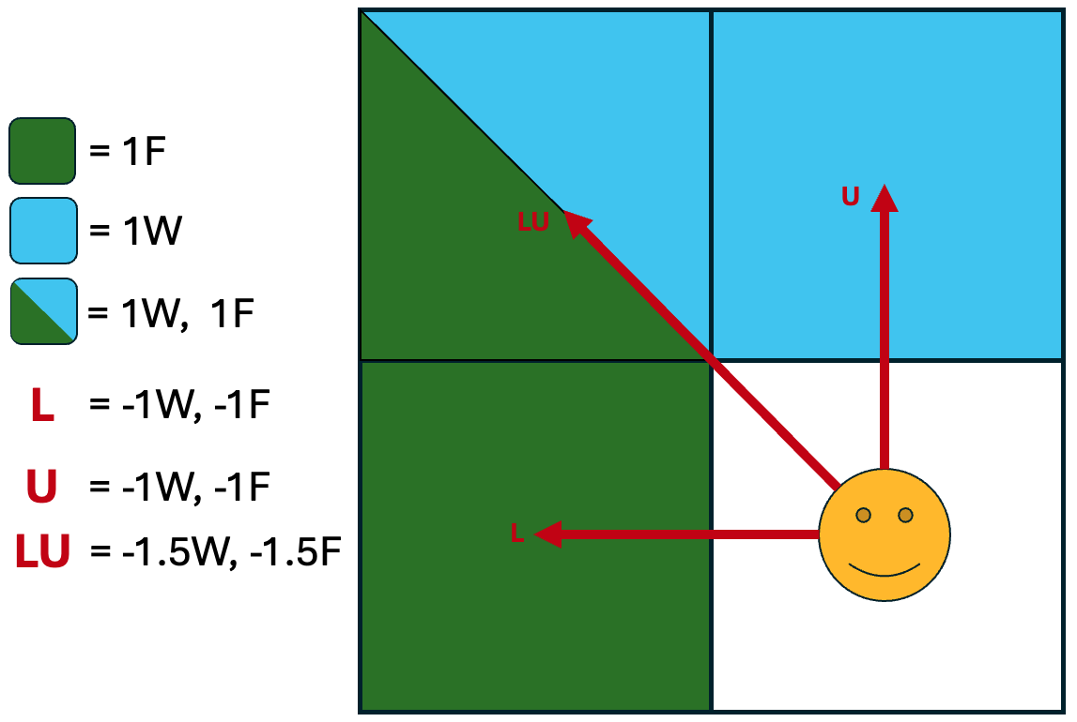
Background & Related Work
Deep W-Learning / W-Networks
DWN
$${\text{Model}}_{1}$$
$$a_{1}$$
Selector
DQN
Strengths:
Train Greedy DQNs simultaneously.
Learns the Pareto Front.
Naturally divides the state space.
Human Preference Weights are applied Post-Hoc to the W-values.
W-network
$$w_{1}$$
$$argmax_{i}[w_{i}]$$
Select the action with the highest associated W-Value
$${\text{Model}}_{n}$$
$$a_{n}$$
DQN
W-network
$$w_{n}$$
$$i,a_{i}$$
State
Environment
$$a_{i}$$
Weaknesses:
Computationally Intensive.
Human Preference Integration is not clearly understood.
Unable to select collaborative actions.
Reward N
Reward 1
$$Q_{j}\left(s_{t},a_{t,i}\right)←Q\left(s_{t},a_{t,i}\right)+α_{q}\left[r_{t,j}+γ{\max_{ }}_{a_{t+1}}{Q\left(s_{t+1},a_{t+1}\right)}−Q\left(s_{t}, a_{t,i}\right)\right]$$
[1]
$$W_{j}\left(s_{t}\right)←\left(1−α_{w}\right)W_{j}\left(s_{t}\right)+α_{w}\left[Q_{j}\left(s_{t},a_{i}\right)−\left(r_{t,j}+γ\max_{a^{′}}{Q_{j}\left(s_{t+1},a^{′}\right)} \right)\right]$$
[3, 4]

Slide 10
Design
Novel Architecture
Design a Multi-Policy RL Model which takes Collaborative Actions and Applies Human Preferences post-hoc.
Retain from DWN:
Training single objective DQNs in parallel.
Learning the Pareto Front.
Research Goals:
Enable Multi-Policy Collaborative Actions.
Evaluate our Novel Architecture against DWN.
Analyze Human Preference application in DWNs, and our novel Architecture.
New Features:
Ability to select Collaborative Actions.
Additions to DWN:
Modify DWN to take human preference weights.

Slide 11
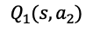
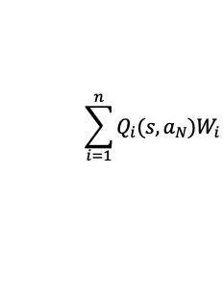
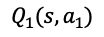





























Design
Novel Architecture Approaches
Democratic DWN
Democratic Network
$${\text{Model}}_{1}$$
$$Q_{1}(s,a_{1})$$
Selector
$${\text{Model}}_{1}$$
Selector
DQN
$$Q_{1}(s,a_{2})$$
DQN
$$Q_{1}(s,a_{1})$$
$$…$$
$$\sum_{i=1}^{n}{Q_{i}\left(s,a_{1}\right)W_{i}}$$
$$Q_{1}(s,a_{2})$$
$$\sum_{i=1}^{n}{Q_{i}\left(s,a_{1}\right)}$$
$$Q_{1}(s,a_{N})$$
W-network
$$w_{1}$$
$$…$$
$$Q_{1}(s,a_{N})$$
$$\sum_{i=1}^{n}{Q_{i}(s,a_{2})W_{i}}$$
$$\sum_{i=1}^{n}{Q_{i}(s,a_{2}) }$$
$$A=$$
$$A=$$
$${\text{Model}}_{n}$$
$$…$$
$${\text{Model}}_{n}$$
$$…$$
$$Q_{n}(s,a_{1})$$
DQN
$$Q_{n}(s,a_{2})$$
$$\sum_{i=1}^{n}{Q_{i}(s,a_{N})W_{i}}$$
DQN
$$Q_{n}(s,a_{1})$$
$$\sum_{i=1}^{n}{Q_{i}(s,a_{N}) }$$
$$…$$
$$Q_{n}(s,a_{2})$$
$$Q_{n}(s,a_{N})$$
W-network
$$w_{n}$$
$$…$$
$$Q_{n}(s,a_{N})$$
$$a_{i}=argmax_{i}[A_{i}]$$
$$a_{i}=argmax_{i}[A_{i}]$$
$$a_{i}$$
$$a_{i}$$
State
Environment
$$a_{i}$$
State
Environment
$$a_{i}$$
Reward N
Reward N
Reward 1
Reward 1

Slide 12
Design
Democratic DWN Analysis
Democratic DWN
$${\text{Model}}_{1}$$
Selector
Strengths:
Enables Collaborative action selection.
Retains Division of State Space through W-learning.
Post-Hoc weights can be applied to W-values during summation.
$$Q_{1}(s,a_{1})$$
DQN
$$Q_{1}(s,a_{2})$$
$$…$$
$$\sum_{i=1}^{n}{Q_{i}\left(s,a_{1}\right)W_{i}}$$
$$Q_{1}(s,a_{N})$$
W-network
$$w_{1}$$
$$\sum_{i=1}^{n}{Q_{i}(s,a_{2})W_{i}}$$
$$A=$$
$${\text{Model}}_{n}$$
$$…$$
$$Q_{n}(s,a_{1})$$
DQN
$$Q_{n}(s,a_{2})$$
$$\sum_{i=1}^{n}{Q_{i}(s,a_{N})W_{i}}$$
$$…$$
Drawbacks:
Computationally intensive.
Difficult to assign updates to W-networks.
$$Q_{n}(s,a_{N})$$
W-network
$$w_{n}$$
$$a_{i}=argmax_{i}[A_{i}]$$
$$a_{i}$$
State
Environment
$$a_{i}$$
Reward N
Reward 1

Slide 13
Design
Democratic Network Analysis
Democratic Network
Strengths:
Enables Collaborative action selection.
Post-Hoc weights can be applied during Selector summation.
Computationally less intensive.
$${\text{Model}}_{1}$$
Selector
DQN
$$Q_{1}(s,a_{1})$$
$$Q_{1}(s,a_{2})$$
$$\sum_{i=1}^{n}{Q_{i}\left(s,a_{1}\right)}$$
$$…$$
$$Q_{1}(s,a_{N})$$
$$\sum_{i=1}^{n}{Q_{i}(s,a_{2}) }$$
$$A=$$
$${\text{Model}}_{n}$$
$$…$$
DQN
$$Q_{n}(s,a_{1})$$
$$\sum_{i=1}^{n}{Q_{i}(s,a_{N}) }$$
Drawbacks:
No longer learns W-values to divide up the state space.
Thus, Reward Shaping is more important.
$$Q_{n}(s,a_{2})$$
$$…$$
$$Q_{n}(s,a_{N})$$
$$a_{i}=argmax_{i}[A_{i}]$$
$$a_{i}$$
State
Environment
$$a_{i}$$
Reward N
Reward 1

Slide 14


Implementation
Implementing These Models
Review:
The current state-of-the-art MORL Models
Methods of Human Preference Integration
Design a Collaborative ML Architecture with Post-Hoc Preference integration.
Test and Evaluate the Novel Architecture using DWN experiments.
Analyse the the Impact of Human Preference integration.

Slide 15
Evaluation
Evaluation Purpose
We want to evaluate:
The ability for Democratic Networks to take optimal, collaborative actions in environments.
The performance of Democratic Networks compared to DWNs in multiple environments.
Analyze the impact of human preference integration on Democratic Networks and DWN.

Slide 16



Evaluation
Experiment Environment
Collaboration
Deep Sea Treasure
Mountain Car
Has balanced reward space.
Single objective optimality does not equate to Multi-Objective optimality.
Showcases a known pareto front.
Has Imbalanced Reward Space
Has Three Objectives
Has a sparse Reward Space.

Slide 17
Evaluation
Evaluation Process
For Each Environment:
Train DQNs and WNs using DWN and use them for Democratic Networks.
Evaluate W-Value changes over time.
For several sets of possible human preferences:
Compare Performance by comparing the Selected Actions.
Analyze State Space Division.
Average Reward over 100 episodes.

Slide 18

Evaluation
Collaborative Environment Analyzing Q-values
Index | Action
0 | NOOP
1 | Left
2 | Right
3 | Up
4 | Down
5 | Left-Up
6 | Right-Up
7 | Left-Down
8 | Right-Down

Slide 19


Evaluation
Collaborative Environment Action Selection
DWN Action Selection
Democratic Action Selection

Slide 20


Evaluation
Deep Sea Treasure Action Selection
DWN Action Selection
Democratic Action Selection

Slide 21
Conclusions
Takeaways So Far
Lessons Learnt:
I have developed my understanding of MORL concepts.
Improved my understanding of core ML theory and concepts.
Key Takeaways:
MORL research is diverse and highly fragmented.
The area of Human Preference integration/application is understudied.
Initial evaluation indicates Democratic Networks are able to select collaborative actions.

Slide 22
Conclusions
What’s left?
Implement other methods of Human Preference Integration for DWNs and Democratic DWNs.
Train our models for our selected environments.
Evaluate model performance across each Human Preference Integration approach.
Compare Model performance across several sets of human preferences for each integration approach.
Indicate areas of further research.

Slide 23
References
[1] C. J. C. H. Watkins and P. Dayan, “Q-learning,” Machine Learning, vol. 8, no. 3-4, pp. 279–292, 1992.
[2] K. Van Moffaert, M. M. Drugan and A. Nowé, "Scalarized multi-objective reinforcement learning: Novel design techniques," 2013 IEEE
Symposium on Adaptive Dynamic Programming and Reinforcement Learning (ADPRL), Singapore, 2013, pp. 191-199, doi:
10.1109/ADPRL.2013.6615007.
[3] Humphrys, Mark. (2000). W-learning: Competition among selfish Q-learners.
[4] Jernej Hribar, Luke Hackett, and Ivana Dusparic. (2023). Deep W-Networks: Solving Multi-Objective Optimisation Problems with Deep
Reinforcement Learning. 10.48550/arXiv.2211.04813.
[5] Chunming Liu, Xin Xu, and Dewen Hu. 2014. Multiobjective reinforcement learning: A comprehensive overview. IEEE Transactions on
Systems, Man, and Cybernetics: Systems 45, 3 (2014), 385–398.
[6] Kristof Van Moffaert and Ann Nowé. “Multi-Objective Reinforcement Learning using Sets of Pareto Dominating Policies”. In: Journal of
Machine Learning Research 15.107 (2014), pp. 3663–3692. URL: http://jmlr.org/papers/v15/vanmoffaert14a.html.
[7] R.S. Sutton and A.G. Barto. Reinforcement Learning, second edition: An Introduction. Adaptive Computation and Machine Learning series.
MIT Press, 2018. ISBN: 9780262352703.
[8] Q. Zhang and H. Li, "MOEA/D: A Multiobjective Evolutionary Algorithm Based on Decomposition," in IEEE Transactions on Evolutionary
Computation, vol. 11, no. 6, pp. 712-731, Dec. 2007, doi: 10.1109/TEVC.2007.892759
[9] Kristof Van Moffaert, Madalina M. Drugan, and Ann Nowé. “Hypervolume-Based Multi-Objective Reinforcement Learning”. In:
Evolutionary Multi-Criterion Optimization. Ed. by Robin C. Purshouse et al. Berlin, Heidelberg: Springer Berlin Heidelberg, 2013,
pp. 352–366. ISBN: 978-3-642-37140-0.
[10] Axel Abels, Diederik Roijers, Tom Lenaerts, Ann Nowé, and Denis Steckelmacher. Dynamic weights in multi-objective deep reinforcement
learning. In International Conference on Machine Learning, pp. 11–20. PMLR, 2019.
[11] K. Deb, A. Pratap, S. Agarwal and T. Meyarivan, "A fast and elitist multiobjective genetic algorithm: NSGA-II," in IEEE Transactions on
Evolutionary Computation, vol. 6, no. 2, pp. 182-197, April 2002, doi: 10.1109/4235.996017.
[12] Runzhe Yang, Xingyuan Sun, and Karthik Narasimhan. A Generalized Algorithm for Multi-Objective Reinforcement Learning and Policy
Adaptation. 2019. arXiv:1908.08342 [cs.LG]. URL: https://arxiv.org/abs/1908.08342.
[13] Toygun Basaklar, Suat Gumussoy, and Umit Y. Ogras. PD-MORL: Preference-Driven Multi-Objective Reinforcement Learning Algorithm.
2023. arXiv: 2208.07914 [cs.LG]. URL: https://arxiv.org/abs/2208.07914.
[14] Mirzanejad M, Ebrahimi M, Vamplew P, Veisi H. An online scalarization multi-objective reinforcement learning algorithm:
TOPSIS Q-learning. The Knowledge Engineering Review. 2022;37:e7. doi:10.1017/S0269888921000163

Slide 24
Questions ?

Slide 25
Thank You

Slide 26









Background & Related Work
Deep Q-Networks (DQN)
ENV
$$s_{1}$$
DQN
NN
$$a_{i}=\underset{i}{argmax}{Q(s,a_{i})}$$
$$Q(s,a_{1})$$
$$Q(s,a_{2})$$
$$Q(s,a_{n})$$
$$s_{2}$$
$$r_{1}$$
$$r_{1}+γQ(s_{2},a_{max})$$
Learning Rate
Discount Factor
$$Q\left(s_{t},a_{t}\right)←Q\left(s_{t},a_{t}\right)+α [r_{t}+γ{\max_{ }}_{a}{Q\left(s_{t+1},a\right)}−Q\left(s_{t}, a_{t}\right)]$$
New Q-Value
Q-Value
Reward
For taking action $a_{t}$
in state $s_{t}$
Maximum Q-Value in Next State
Q-Value

Slide 27




Background & Related Work
RL vs MORL
Scalarization
Multi-Solution
$$R={θ_{1}R}_{1}+θ_{2}R_{2}+…+θ_{n}R_{n}$$
$$s$$
Model
$$a_{θ1}$$
Model
Model
$$s$$
$$a$$
$$s$$
$$a_{θ2}$$
$$s$$
Model
$$a_{θ3}$$
Preference Learning
Multi-Policy
Model
$$s$$
Model
$${\text{Model}}_{1}$$
$$o_{1}$$
Selector
$$θ$$
$$a$$
$$s$$
$${\text{Model}}_{2}$$
$$a$$
$$o_{2}$$
$${\text{Model}}_{n}$$
$$o_{n}$$

Slide 28








Background & Related Work
What is RL?
Reinforcement Learning (RL)
Agent
Goal = Maximize Reward
state
$$S_{t}$$
reward
$$R_{t}$$
action
$$A_{t}$$
$$R_{t+1}$$
Environment
$$S_{t+1}$$

Slide 29

























Design
Novel Architecture Approaches (Scaled)
Scaled Democratic DWN
Scaled Democratic Network
$${\text{Model}}_{1}$$
Selector
$${\text{Model}}_{1}$$
Selector
DQN
$$Q_{1}(s,a_{1})$$
softmax
$$D_{1,1}$$
DQN
$$Q_{1}(s,a_{1})$$
$$Q_{1}(s,a_{2})$$
$$D_{1,2}$$
softmax
$$D_{1,1}$$
$$…$$
$$…$$
$$\sum_{i=1}^{n}{D_{i,1}W_{i}}$$
$$Q_{1}(s,a_{2})$$
$$D_{1,2}$$
$$\sum_{i=1}^{n}{D_{i,1}}$$
$$Q_{1}(s,a_{N})$$
$$D_{1,N}$$
$$…$$
$$…$$
W-network
$$w_{1}$$
$$D_{1,N}$$
$$Q_{1}(s,a_{N})$$
$$\sum_{i=1}^{n}{D_{i,2}W_{i}}$$
$$\sum_{i=1}^{n}{D_{i,2} }$$
$$A=$$
$$A=$$
$${\text{Model}}_{n}$$
$$…$$
$${\text{Model}}_{n}$$
$$…$$
DQN
$$Q_{n}(s,a_{1})$$
softmax
$$D_{n,1}$$
$$\sum_{i=1}^{n}{D_{i,N} W_{i}}$$
DQN
$$\sum_{i=1}^{n}{D_{i,N} }$$
$$Q_{n}(s,a_{2})$$
$$D_{n,2}$$
$$Q_{n}(s,a_{1})$$
softmax
$$…$$
$$…$$
$$Q_{n}(s,a_{2})$$
$$D_{1,1}$$
$$Q_{n}(s,a_{N})$$
$$D_{n,N}$$
$$D_{1,2}$$
$$w_{n}$$
$$…$$
$$…$$
W-network
$$D_{1,N}$$
$$Q_{n}(s,a_{N})$$
$$a_{i}=argmax_{i}[A_{i}]$$
$$a_{i}=argmax_{i}[A_{i}]$$
$$a_{i}$$
$$a_{i}$$
State
Environment
$$a_{i}$$
State
Environment
$$a_{i}$$
Reward N
Reward N
Reward 1
Reward 1
The purpose of this is to facilitate functioning in Environments with unbalanced rewards.

Slide 30




Evaluation
Evaluating MORL Models
$$P=\{x∣∄x^{′} s.t. x≻x′\}$$
$$x≻x^{′}⇔∀i∈\left\{1,2,…,n\right\}{ x}_{i}≥x_{i}^{′}$$

Slide 31

Evaluation
Collaborative Environment Analyzing W-Value
W-Values Over Training

Slide 32


Evaluation
Collaborative Environment
Rewards During Training
Loss
Objective 1
Reward
Objective 2
Reward

Slide 33




Evaluation
Comparing Different Human Preferences
Human Preferences |  | Model
Objective1 | Objective 2 | DWN | Democratic
100% | 0%
0% | 100%

Slide 34




Implementation
Implementing These Models
https://github.com/JuanK120/RL_EWS

Slide 35

Evaluation
Deep Sea Treasure Action Selection W-Values

